Slide 1
MTA Targeted Marketing Applications

Slide 2
Problem Statement
Leveraging Public Transportation Ridership Patterns to attract private investments and/or revenue from corporate sources.
The main goal is for corporations to patron certain stations of the existing in exchange for running blanket ads.

Slide 3
Huh? What do you guys do again?
We are a business facing project which provides a platform for businesses to run spatially targeted ads
Provide rebates on ticket fare to the MTA user by leveraging in-coach ad rev
Provide a spatially targeted billboard marketing solution

Slide 4
Who is it for?
The primary persona of a user are for the Sales and Marketing division of medium to large corporations.
The secondary consumer is the average Joe using the subway lines.

Slide 5
But, how?
Techie Jargon
Mine rider data
Develop robust live streaming solution
Explore the idea of Local hub
Make use of spatial nature of data
What we really mean
Which are the most used stations?
Make some Vibranium grade platform!
Where do people get/switch rides?
Which neighbours are really good at spreading the word?

Slide 6
Can you be more specific?
We have Identified two main use cases:
Active Marketing (in-coach): Make the tickets cheaper while sharing who helped with the fare.
Passive Marketing (Bill board): The good old poster/billboard marketing space

Slide 7
Let’s have a look under the hood

Slide 8
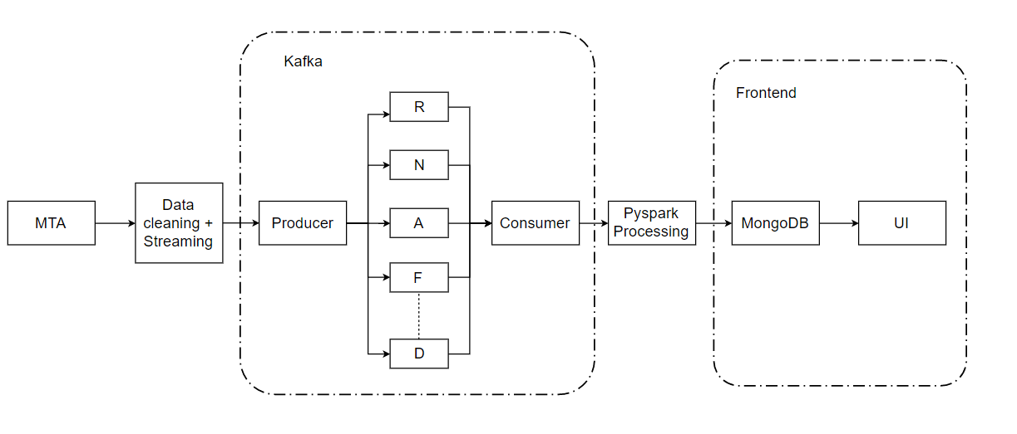
Architecture Diagram
*Currently Processing only R F and D lines

Slide 9
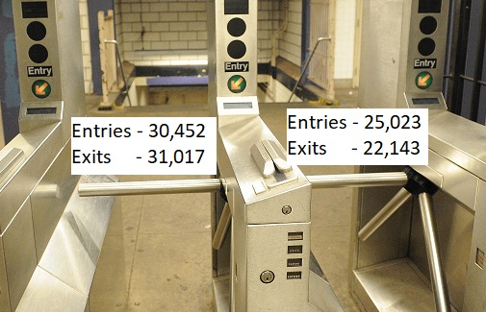
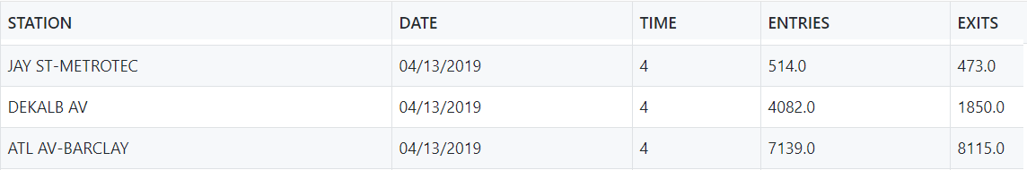
Data Streaming/ Kafka
MTA provides number of entry/exits for each turnstile of each station.
File for each day contains the above data for every four hours and is dumped every night on the MTA website.
We use this data to create a Kafka stream of station data creating a topic for each line.

Slide 10
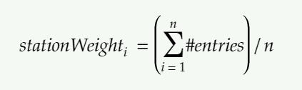
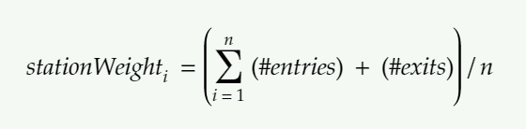

Analysis: Pyspark Streaming
Weight of each station for subsidy -
Weight of each station for ads -
Price of each station for subsidy -
Price of each station for ads -

Slide 11
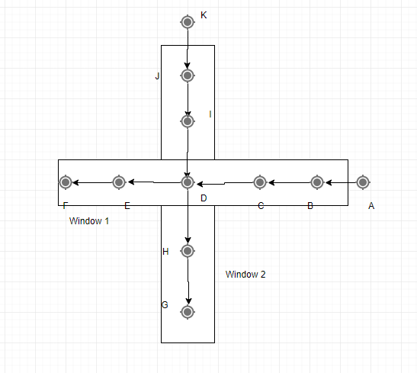
Why a sliding window?
To understand the local hubs
Example: Traffic st Atlantic street is more or less independent of traffic at Lexington Ave

Slide 12
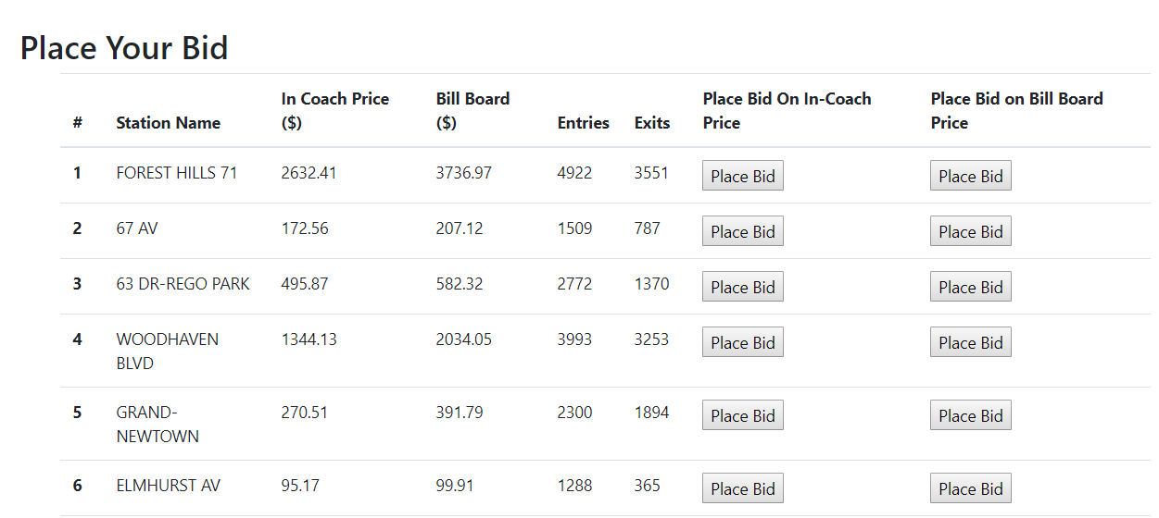
MongoDB and NodeJS
After processing the MTA data, this data is dumped into a MongoDB collection.
Each row of the collection contains the Station name, incoach price, advertisement price, number of entries and exits
This data is then used by the front end to provide UI for a bidding system

Slide 13
Feasibility and Scalability
The producer-consumer system can scale as much as required owing to data being funneled into topics for each MTA Line
Feasibility is guaranteed as the system is independent of MTA operations and no extra data is required

Slide 14

Demo - Show me the money!

Slide 15
Future work ?
Stress testing the subsidy metric
Building modular and appealing frontend for various user personas
Providing cheaper options for local ads

Slide 16




The Team: Open for questions!
Utkarsh Prakash
Tanay Varshney
Ashim Aggarwal
Jay Shah
Masters in Computer Science Student at NYU, Tandon
Masters in Computer Science Student at NYU, Tandon
Masters in Computer Science Student at NYU, Tandon
Masters in Computer Science Student at NYU, Tandon

